Slide 1

VISUAL EXPLORATION ON TOURISM
MAUL SRI M
DA/DS JULY B5
20-02-2025

Slide 2
INTRODUCTION
Explores key trends in traveler behavior.
Offers a data-driven understanding of tourism trends.
Charts illustrates the impact of peak travel periods.
Analysis highlights distinct pattern in travel.

Slide 3
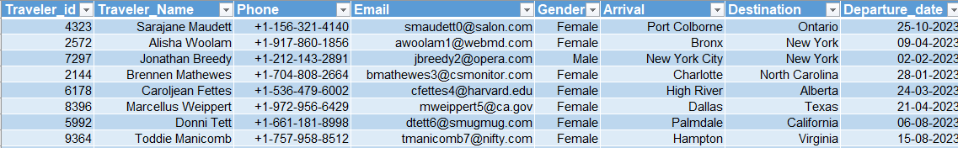
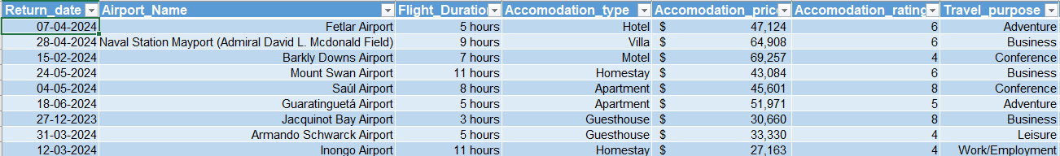
DATA PREVIEW

Slide 4
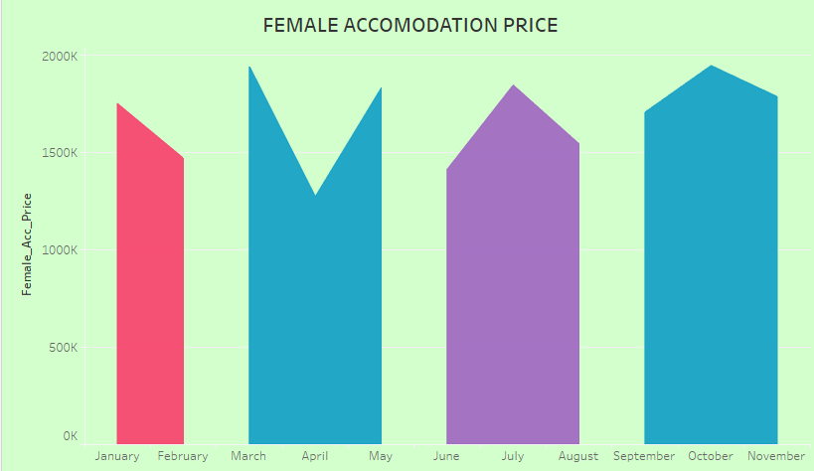
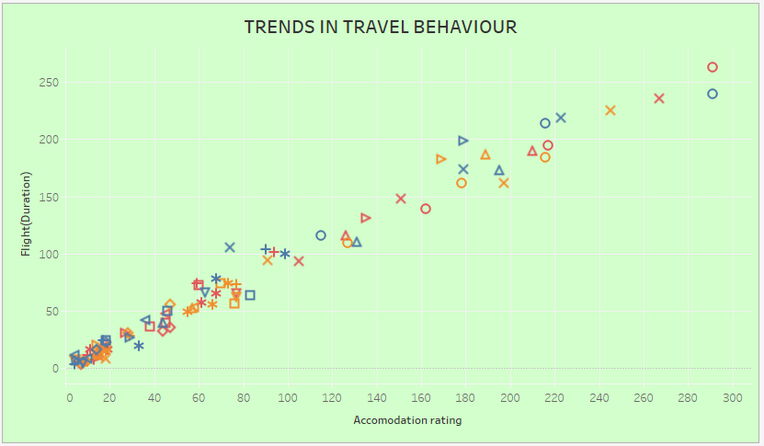
TRENDS AND PATTERN
Express the demand on March and October.
Males are the most frequent traveler.

Slide 5
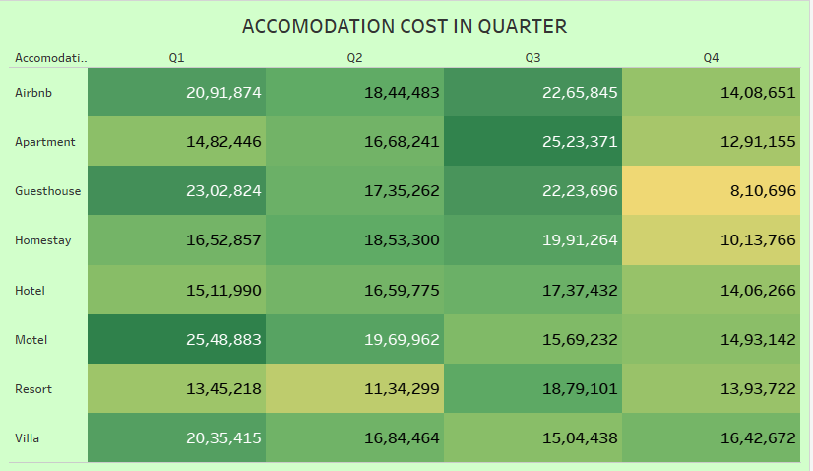
CORRELATION
Highest accommodation type
Q1 -> Motels
Q2 -> Homestay
Q3 -> Apartment
Q4 ->Motels

Slide 6
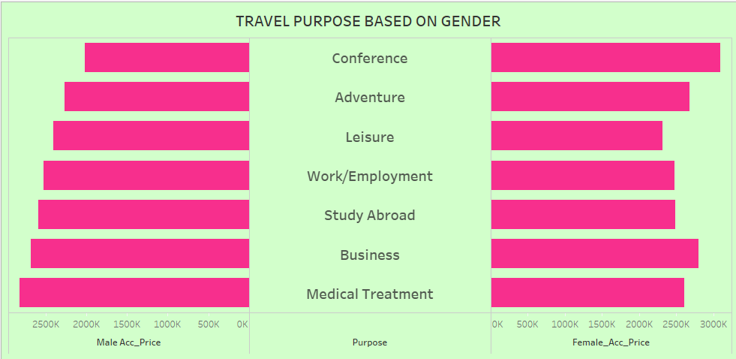
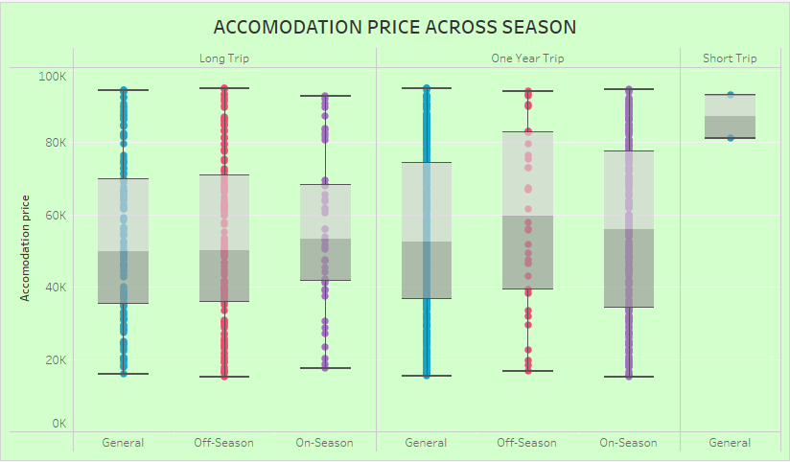
TRENDS AND OUTLIERS
Male spend for medical treatment.
Female spend for conference.
Travel during off-season is cost-effective.

Slide 7
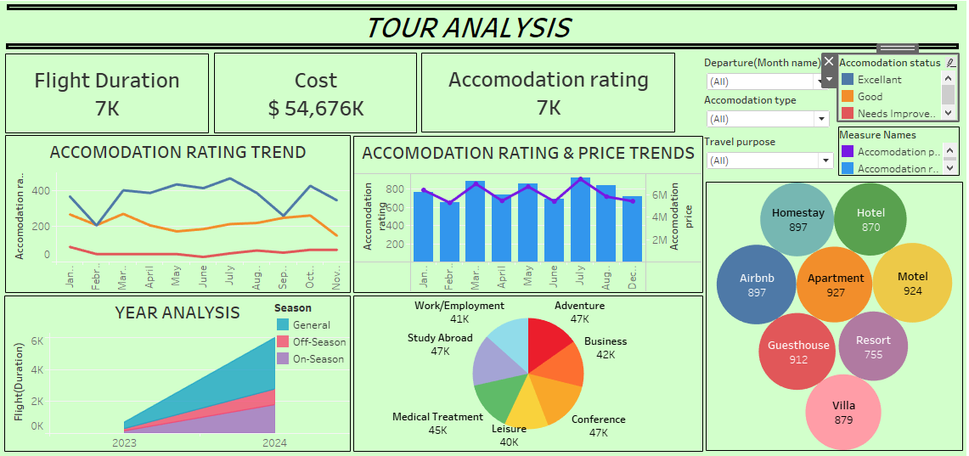
DASHBOARD

Slide 8
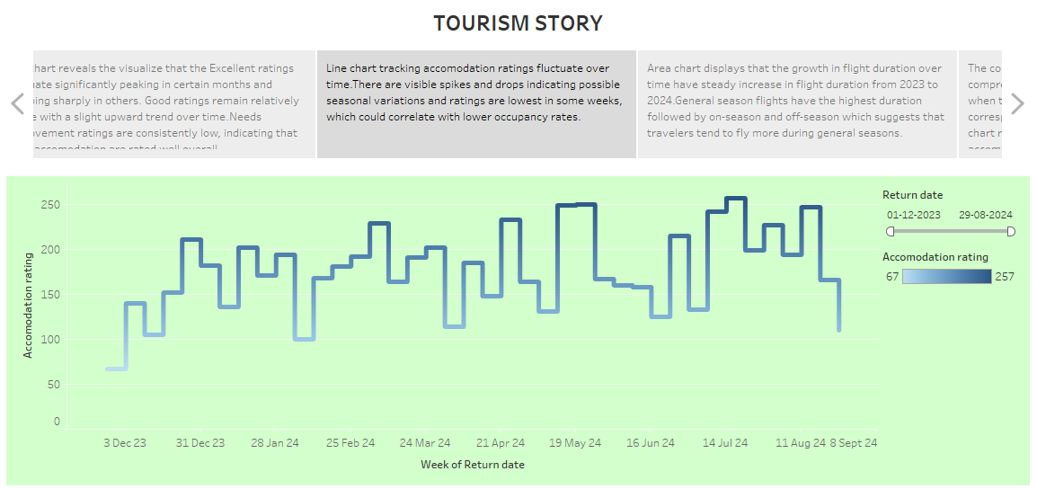
STORY TELLING

Slide 9
KEY TAKEAWAYS
On-Season have higher accommodation ratings.
Quarter Q3 and Q4 show spikes in travel related expenses.
Travelers can choose off-season month for cost-effective trips.
Apartments and homestays being more frequently chosen.
Short trip making them flexible for travel.

Slide 10
RECOMMENDATION
Attract more travelers during off-seasons.
Optimize Pricing Based on Seasonal Trends.
Offering specialized accommodations for medical treatments
Reduce pressure during peak seasons while increasing bookings

Slide 11
CONCLUSION
Highlights clear seasonal pattern in travel.
Travel metrics over quarters.
Suggesting that specific seasons impact the overall experience.
Factors that contribute to their overall satisfaction.

Slide 12
THANK YOU

